Slide 1
Graphs
CSI 219 – Discrete Mathematics

Slide 2
Graph representation

Slide 3
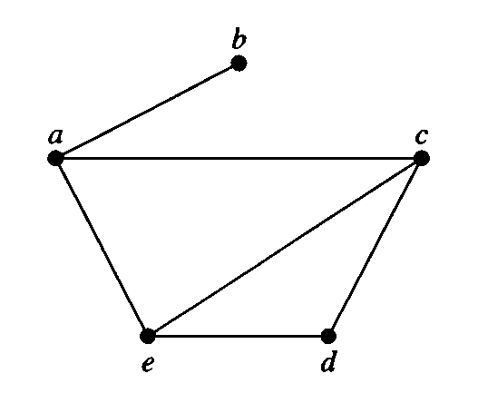

Adjacency list
Vertex Adjacent vertices
$a$ $b,c,e$
$b$ $a$
$c$ $a,d,e$
$d$ $c,e$
$e$ $a,c,d$

Slide 4
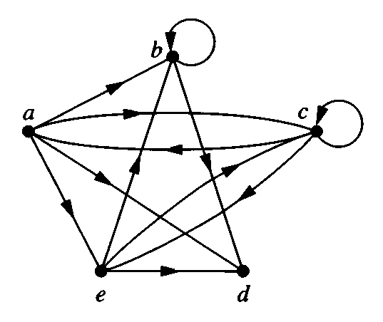

Adjacency list
Initial Terminal vertices
$a$ $b,c,d,e$
$b$ $b,d$
$c$ $a,c,e$
$d$
$e$ $b,c,d$

Slide 5
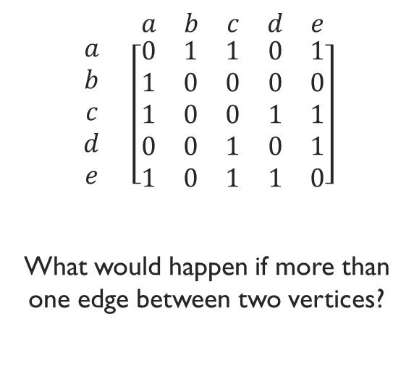
Adjacency matrix
$$\begin{matrix} & \begin{matrix}a & b & c & d & e\end{matrix} \\ \begin{matrix}a \\ b \\ c \\ d \\ e\end{matrix} & \left[\begin{matrix}0 & 1 & 1 & 0 & 1 \\ 1 & 0 & 0 & 0 & 0 \\ 1 & 0 & 0 & 1 & 1 \\ 0 & 0 & 1 & 0 & 1 \\ 1 & 0 & 1 & 1 & 0\end{matrix}\right]\end{matrix}$$
What would happen if more than one edge between two vertices?

Slide 6

Adjacency matrix
$$\begin{matrix} & \begin{matrix}a & b & c & d & e\end{matrix} \\ \begin{matrix}a \\ b \\ c \\ d \\ e\end{matrix} & \left[\begin{matrix}0 & 1 & 1 & 1 & 1 \\ 0 & 1 & 0 & 1 & 0 \\ 1 & 0 & 1 & 0 & 1 \\ 0 & 0 & 0 & 0 & 0 \\ 0 & 1 & 1 & 1 & 0\end{matrix}\right]\end{matrix}$$

Slide 7
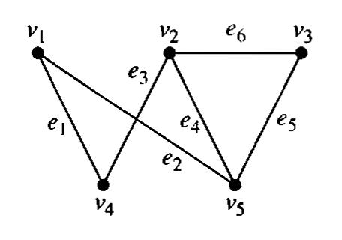
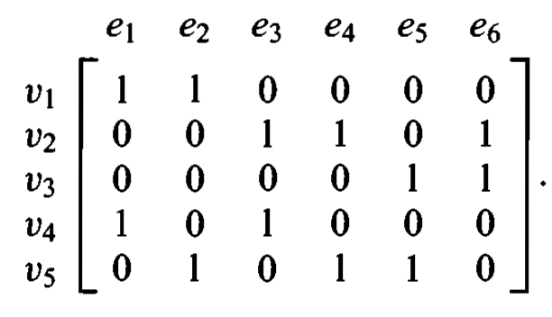
Incidence matrix

Slide 8
Practice problem
Chapter-9.3
4, 8, 9(e), 11, 17

Slide 9
Graph isomorphism
A
B
A
C
D
C
D
B
We can draw the same graph differently
If we can determine that two graphs are actually two different representations of the same graph, then they are called isomorphic

Slide 10
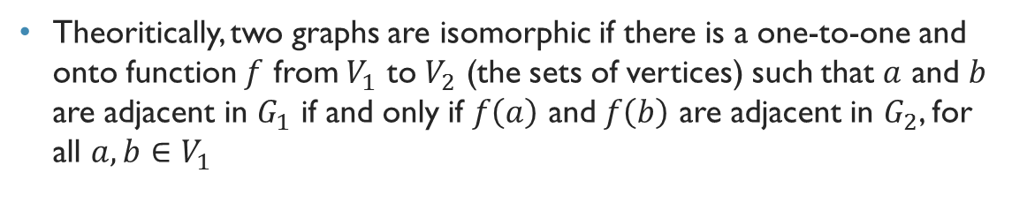
Graph isomorphism
A
B
a
b
D
C
c
d
Theoritically, two graphs are isomorphic if there is a one-to-one and onto function $f$ from $V_{1}$ to $V_{2}$ (the sets of vertices) such that $a$ and $b$ are adjacent in $G_{1}$ if and only if $f\left(a\right)$ and $f\left(b\right)$ are adjacent in $G_{2}$, for all $a,b∈V_{1}$

Slide 11
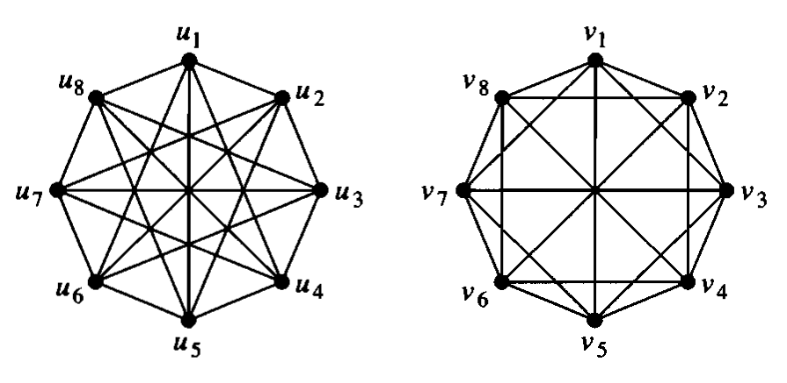
Are these graphs isomorphic?

Slide 12
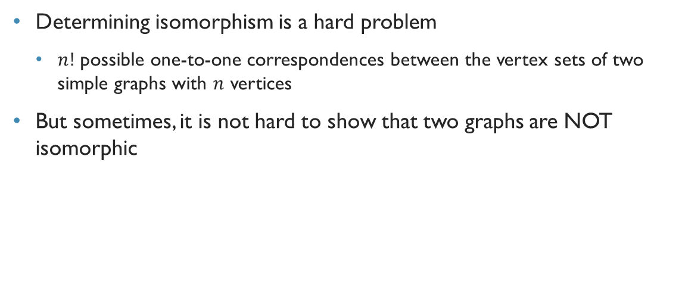
Determining isomorphism
Determining isomorphism is a hard problem
$n!$ possible one-to-one correspondences between the vertex sets of two simple graphs with $n$ vertices
But sometimes, it is not hard to show that two graphs are NOT isomorphic

Slide 13
Are these graphs isomorphic?

Slide 14
Disproving isomorphism: Graph invariants
We can show that two graphs are not isomorphic if we can find a property that only one of the two graphs has, but the property is preserved by isomporphism
Such a property is called a graph invariant
For example, two isomorphic graphs must have the same number of vertices, and the same number of edges as well

Slide 15
Graph invariants
Number of vertices
Number of edges
Degrees of each vertex

Slide 16
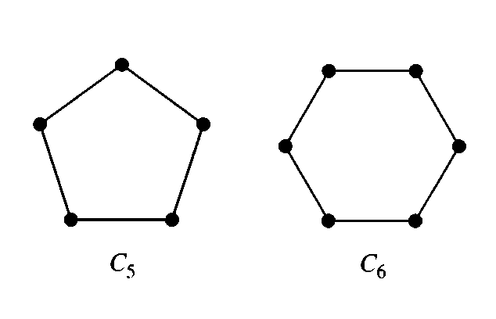
Are these graphs isomorphic?

Slide 17
Are these graphs isomorphic?

Slide 18
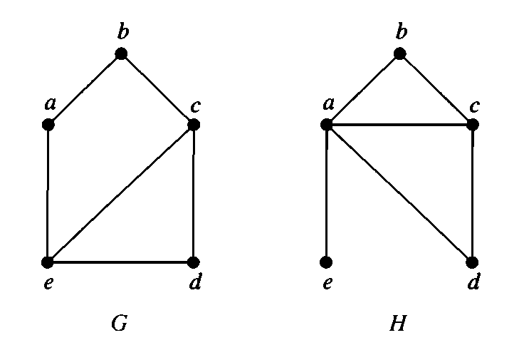
Are these graphs isomorphic?

Slide 19
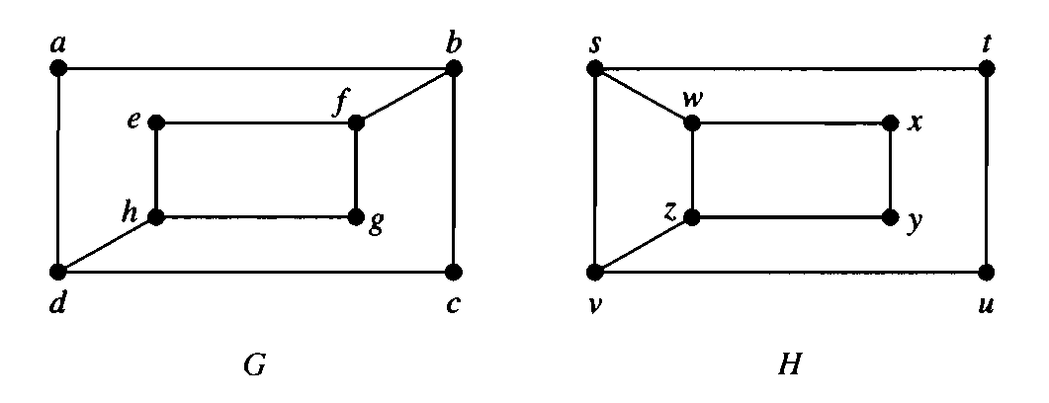

Are these graphs isomorphic?

Slide 20
Graph invariants
Number of vertices
Number of edges
Degrees of each vertex
Degrees of neighbor vertices

Slide 21
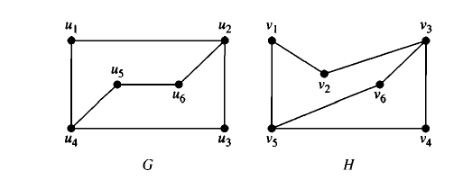
Example

Slide 22
Solution

Slide 23
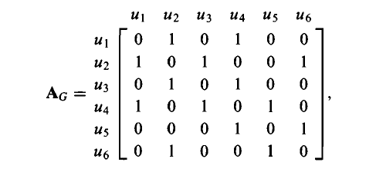
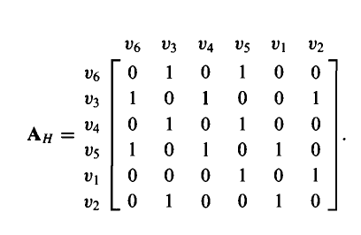
Example

